Slide 1
SyriaTel Customer churn Analysis
A predictive analysis on the possible reasons why customers churn

Slide 2
Introduction
Customer churn is a critical issue for businesses in the telecommunications industry, and it is important to understand the factors that contribute to it.
The purpose of this presentation is to provide an overview of customer churn and its impact on the business, and to present strategies for reducing customer churn for Syriatel.
Through this presentation, we will examine the common reasons for customer churn, the most effective methods for reducing it, and provide recommendations for Syriatel to keep its customers satisfied and loyal.

Slide 3
Understanding Customer Churn
The goal of this slide is to educate the audience on what customer churn is and why it is important to the business.
Customer churn is the rate at which customers stop doing business with a company. It is a measure of customer dissatisfaction and can have a significant impact on the company's revenue and profits.
It is critical to handle customer churn in a company since a high customer churn rates indicate that a large number of customers are leaving the company, leading to a loss of revenue and profits.
It can also harm the company's reputation and brand image, and result in increased marketing and customer acquisition costs.

Slide 4
Types of Churn
Different types of customer churn can include;
Voluntary churn, where customers leave due to dissatisfaction with the service or a better offer from a competitor
Involuntary churn, where customers leave due to circumstances such as a move or a change in financial status. Understanding the different types of customer churn can help companies better target their efforts to reduce it.

Slide 5
Factors Contributing to Customer Churn":
From the analysis of the dataset provided, there are certain features that could be having an impact in the rates of customer churn.
The next slide is the depiction of the level of importance of the various features provided in the dataset, from the most impactful to the least impactful

Slide 6
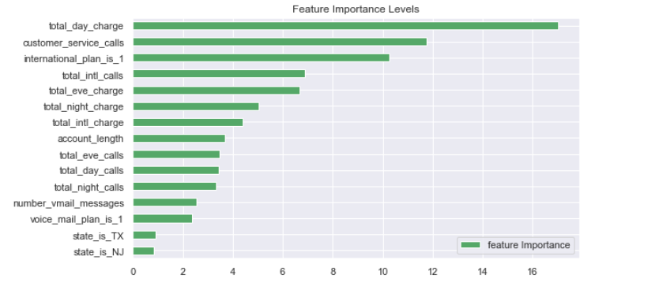
Feature importance
The probable causes of customer churn identified from this analysis are: poor customer service, high total day charges, and frequent international calls

Slide 7
Strategies to reduce customer churn
Strategies for reducing customer churn can include: improving customer service, offering competitive pricing, introducing new and innovative products, and improving network coverage.
In the telecommunications industry, some effective methods for reducing customer churn include offering loyalty programs, providing bundled services, and improving customer service through online support and self-service portals.
If high total day charges are a significant factor in customer churn, offering competitive pricing and bundled services could be an effective strategy. If poor customer service is a key issue, investing in improving support through online portals and customer service could be a priority.
By implementing these strategies, Syriatel can reduce customer churn, increase customer satisfaction, and improve its revenue and profits.

Slide 8
Conclusion and possible recommendation.
In conclusion, customer churn is a critical issue for businesses in the telecommunications industry, and it is important to understand the factors that contribute to it in order to take effective measures to reduce it. By analyzing the data, identifying the root causes of customer churn, and implementing strategies such as improving customer service and offering competitive pricing, Syriatel can reduce customer churn, increase customer satisfaction, and improve its revenue and profits.

